Slide 1

Diana F Camacho
Pricing Analyst II
Waste Management

Slide 2



Final Project Topics
Children’s Education
Deportation in the US
Health and Fitness – Weight Loss

Slide 3



CHILDREN’S EDUCATION
What’s the appropriate age for kids to learn to code?
Hypothesis:
Five years or older is the appropriate age for kinds to learn to code
Data:
https://code.org/ - Seems to have country wide data
Git Hub

Slide 4

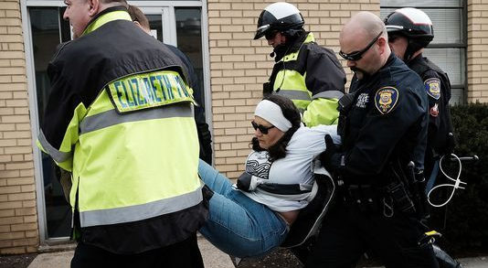

US DEPORTATIONS
What ethnicity is the most affected
Hypothesis:
Latin or Hispanics are the most affected
Data:
https://cis.org/Report/New-Statistics-Enforcement
Government data sites – PD, ICE, US boarder public data sites
https://www.kaggle.com/cbp/illegal-immigrants/data

Slide 5



Health & Fitness – Weight Loss
The weight loss resolution. How many people start with weight loss NYE resolution? Are you loosing those 10lbs?
Hypothesis:
10% of Americans accomplish their weight loss goal
Data:
http://www.americanfitnessindex.org/report/
https://www.hhs.gov/fitness/resource-center/facts-and-statistics/index.html
https://github.com/search?q=health+and+fitness&type=Issues&utf8=%E2%9C%93

Slide 6


Slide 7
Project Requirements – Part I
DELIVERABLES
Lightning Presentation
Requirements: You should present from a prepared deck that explains the following:
The Problem: What's the background and scope of the project idea? What problem are you attempting to address or solve? Who may it matter to?
Data: What data exists to help solve this problem? Where is it coming from? What does the data look like? What is the observation?
Hypotheses: Given the problem and data you're aware of, what do you believe is the solution? What does success look like?
Detailed Breakdown: Your presentation must:
Explain three potential projects, including: a problem statement, a hypothesis, and potential data sets
Be 2-3 minutes in duration
Demonstrate familiarity with the domain of the data
Bonus:
High level data points can help show the "improvement" scope that's available
Cite similar/previous work that will better inform your strategy that can be taken
Submission:
Present materials in class
Submit presentation to instructor via email.

